Slide 1
Chapter 12: The Trials of a King Rod Thom

Slide 2
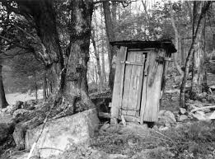

Slide 3
“David commits sins and tries to cover them up.”
2 Samuel 11: 10 David was told, “Uriah did not go home.” So he asked Uriah, “Haven’t you just come from a military campaign? Why didn’t you go home?”
11 Uriah said to David, “The ark and Israel and Judah are staying in tents,[a] and my commander Joab and my lord’s men are camped in the open country. How could I go to my house to eat and drink and make love to
my wife? As surely as you live, I will not do such a thing!”

Slide 4
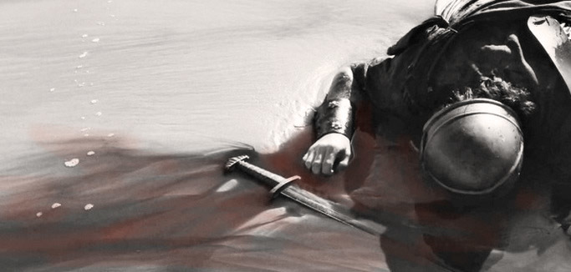
“David commits sins and tries to cover them up.”
2 Samuel 11:15 In it he wrote, “Put Uriah out in front where the fighting is fiercest. Then withdraw from him so he will be struck down and die.”

Slide 5
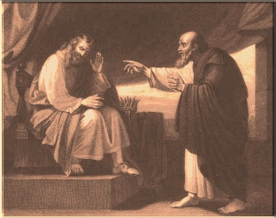
“David’s sins are exposed by God through Nathan the prophet.”
2 Samuel 11:27b But the thing David had done displeased the Lord.
12:1a The Lord sent Nathan to David.

Slide 6
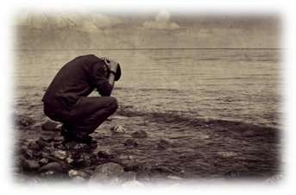
“David’s sins are exposed by God through Nathan the prophet.”
Psalm 51
1 Have mercy on me, O God,
according to your unfailing love;
according to your great compassion
blot out my transgressions.
2 Wash away all my iniquity
and cleanse me from my sin.

Slide 7
“David’s sins are exposed by God through Nathan the prophet.”
3 For I know my transgressions,
and my sin is always before me.
4 Against you, you only, have I sinned
and done what is evil in your sight;
so you are right in your verdict
and justified when you judge.
5 Surely I was sinful at birth,
sinful from the time my mother conceived me.

Slide 8
“David’s sins are exposed by God through Nathan the prophet.”
6 Yet you desired faithfulness even in the womb;
you taught me wisdom in that secret place.
7 Cleanse me with hyssop, and I will be clean;
wash me, and I will be whiter than snow.
8 Let me hear joy and gladness;
let the bones you have crushed rejoice.
9 Hide your face from my sins
and blot out all my iniquity.

Slide 9
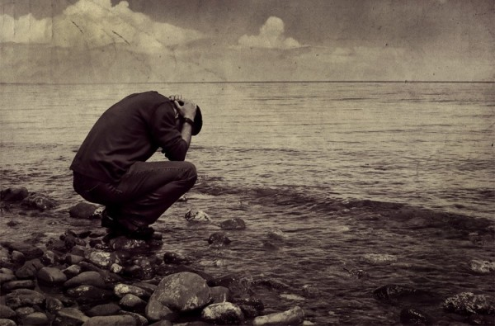
“David’s sins are exposed by God through Nathan the prophet.”
10 Create in me a pure heart, O God,
and renew a steadfast spirit within me.
11 Do not cast me from your presence
or take your Holy Spirit from me.
12 Restore to me the joy of your salvation
and grant me a willing spirit, to sustain me.

Slide 10
“The consequences of David’s sins in his personal life and kingdom.”
2 Samuel 12:20 Then David got up from the ground. After he had washed, put on lotions and changed his clothes, he went into the house of the Lord and worshiped.

Slide 11
“The consequences of David’s sins in his personal life and kingdom.”
2 Chronicles 29:10 David praised the Lord in the presence of the whole assembly, saying,
“Praise be to you, Lord,
the God of our father Israel,
from everlasting to everlasting.

Slide 12
So What? My Response…
Do you have a Nathan in your world and for your soul?
Have you pushed over any “outhouses” lately?
We need to deal with our sin!
-admit our sins honestly to God
-live with the consequences with dignity
-and experience the forgiving, restoring grace of
God

